Slide 1


Data Science with Python
Noble Xavier

Slide 2


Slide 3
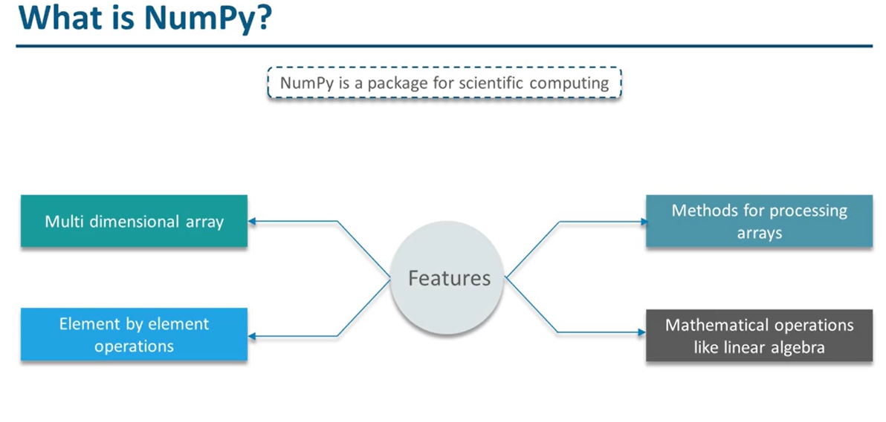

Slide 4
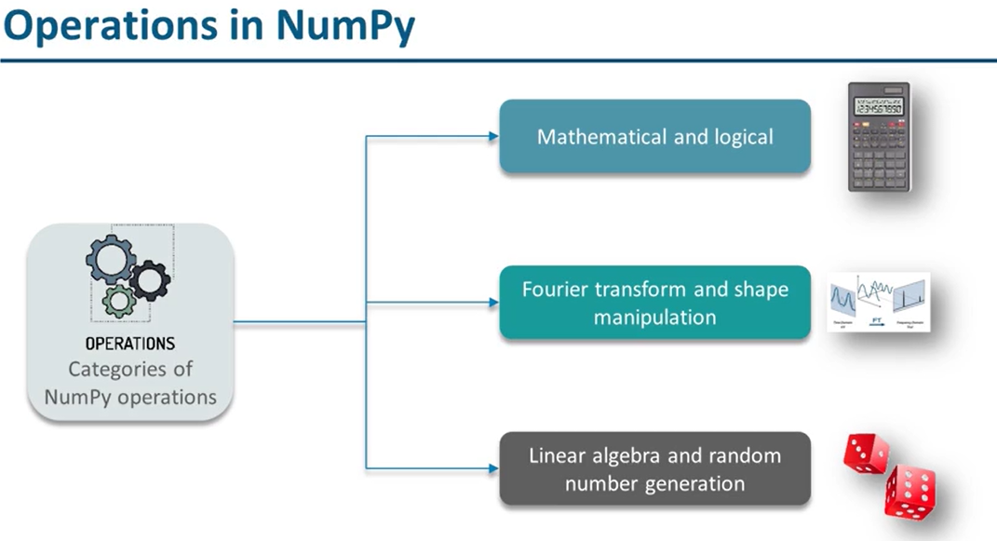

Slide 5
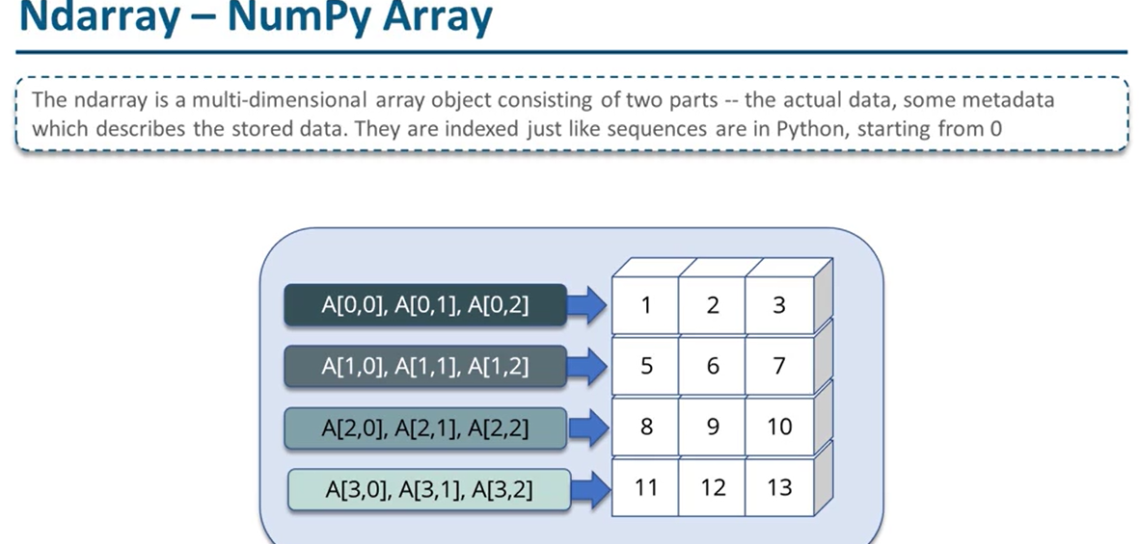

Slide 6
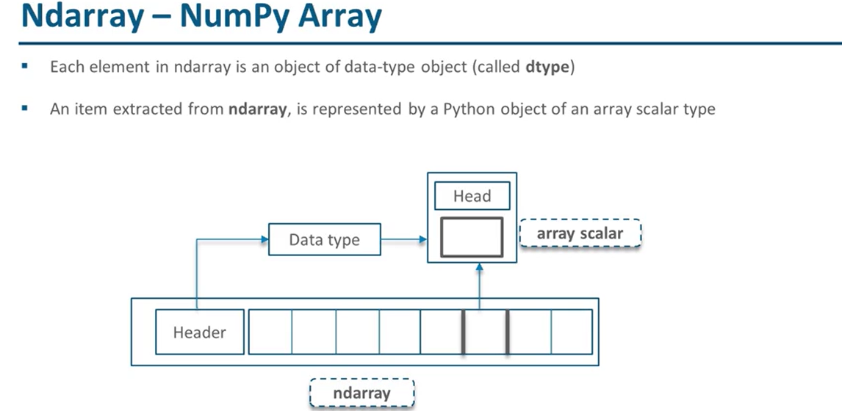

Slide 7
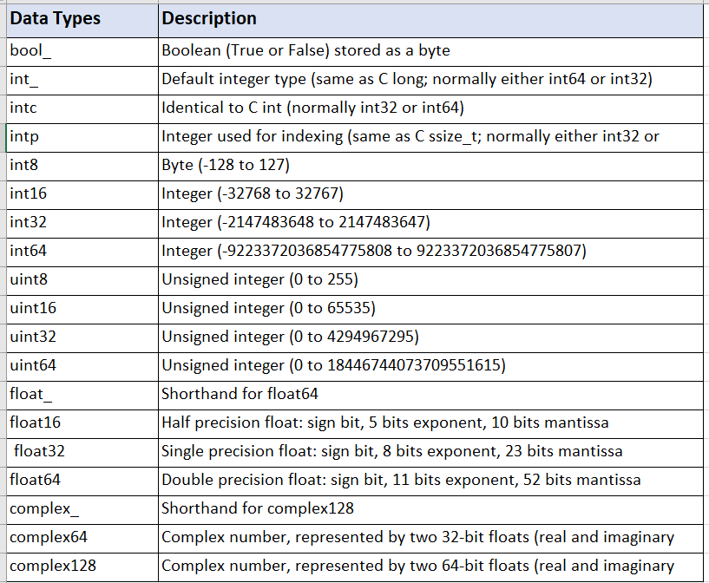
DATA TYPES

Slide 8
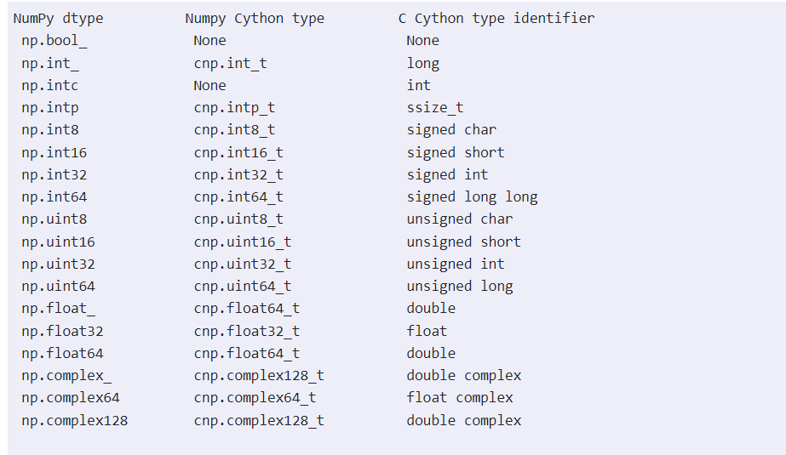
DATA TYPES
Cython is a programming language that aims to be a superset of the Python programming language, designed to give C-like performance with code that is written mostly in Python with optional additional C-inspired syntax. Python is an interpreted programming language. Hence, Python programmers need interpreters to convert Python code into machine code. Whereas Cython is a compiled programming language.
The Cython programs can be executed directly by the CPU of the underlying computer without using any interpreter.

Slide 9
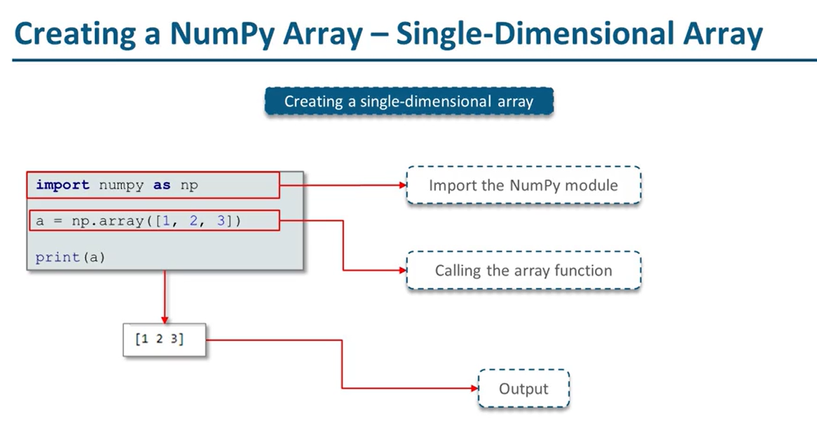

Slide 10
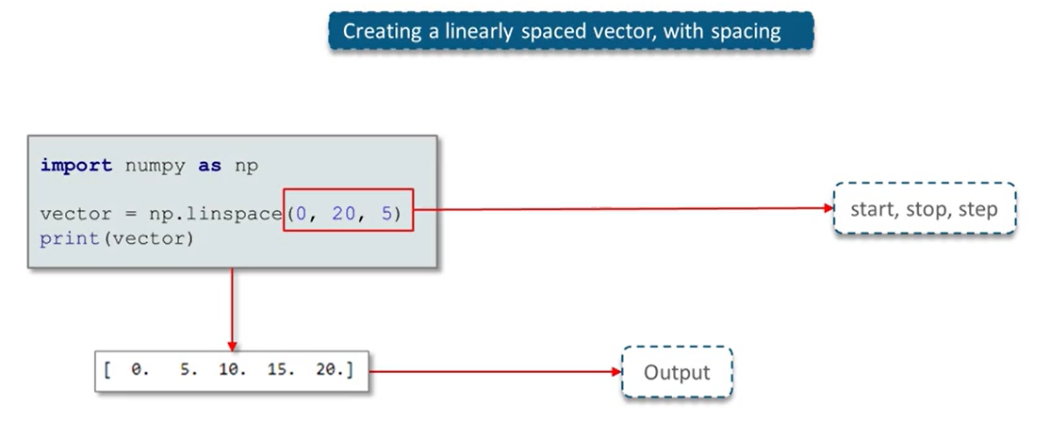

Slide 11
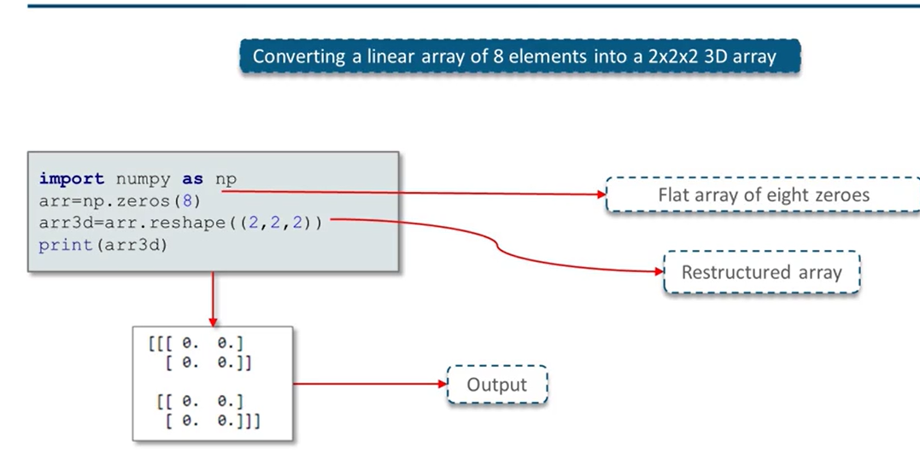

Slide 12
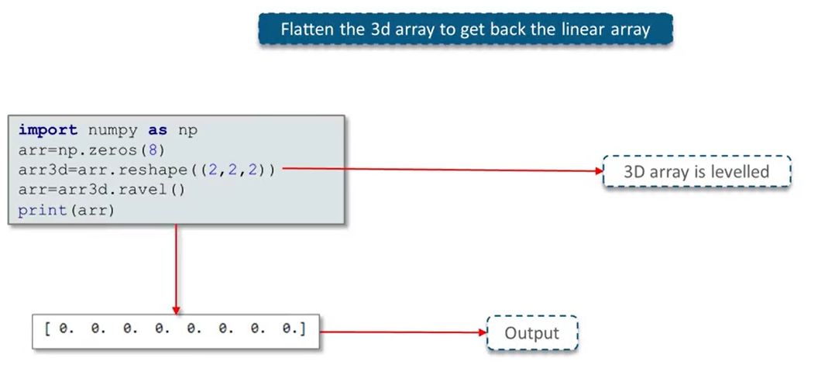

Slide 13
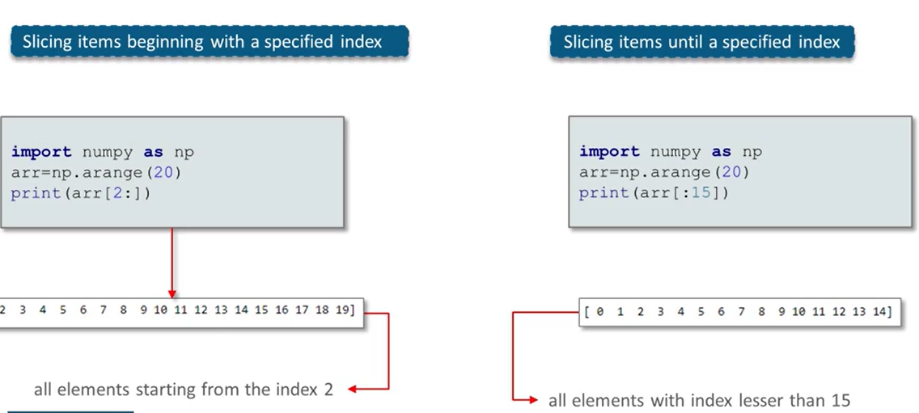

Slide 14
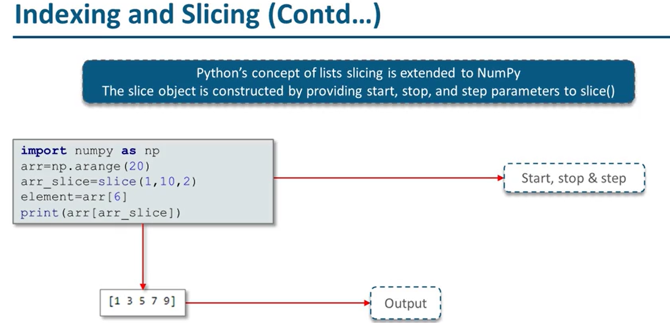

Slide 15
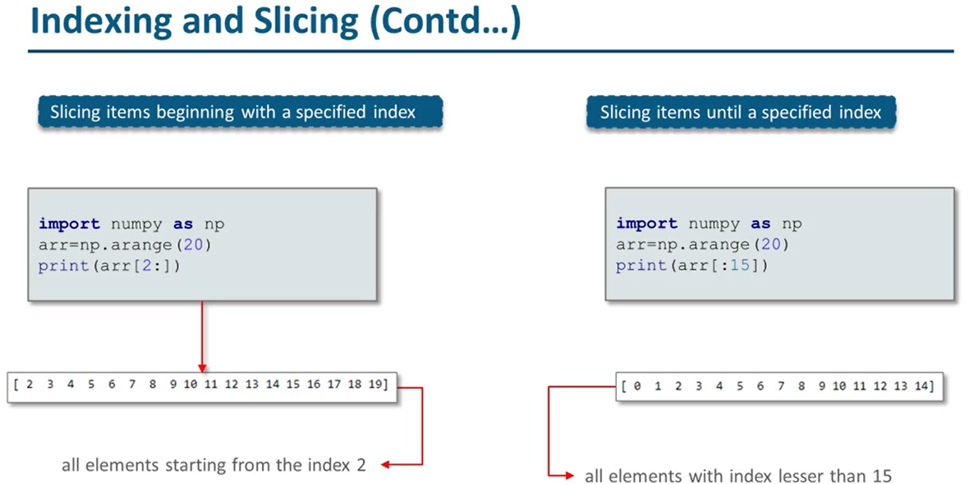

Slide 16
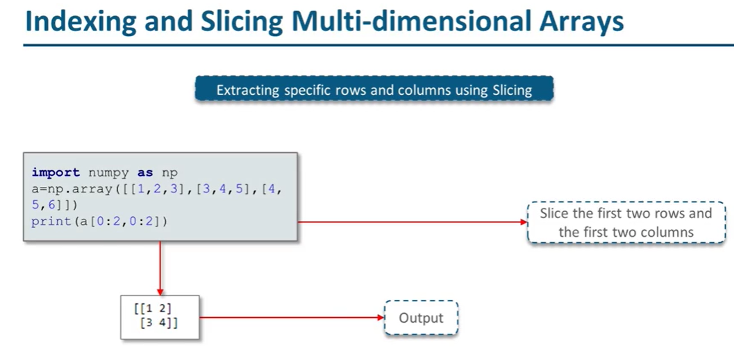

Slide 17
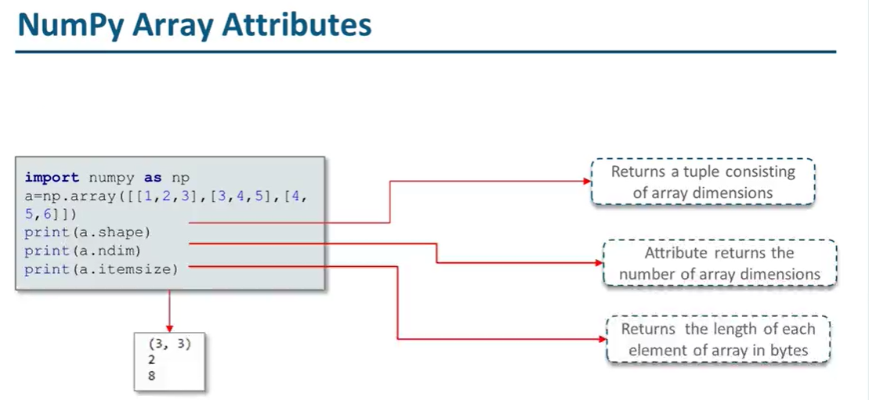

Slide 18
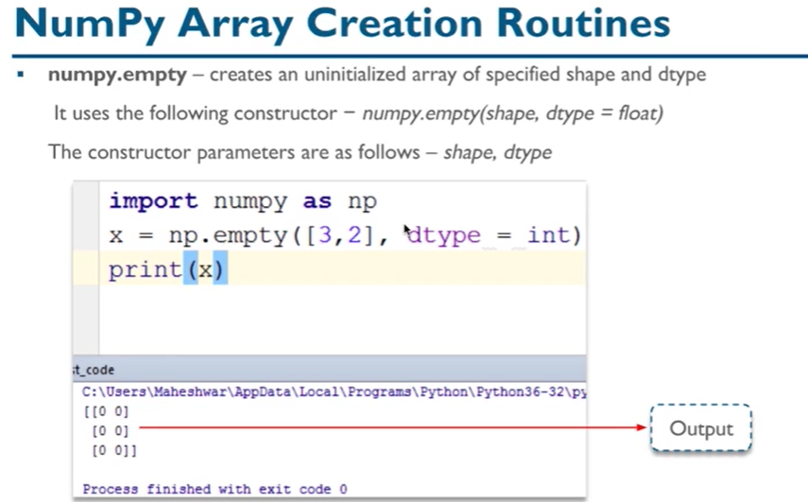

Slide 19
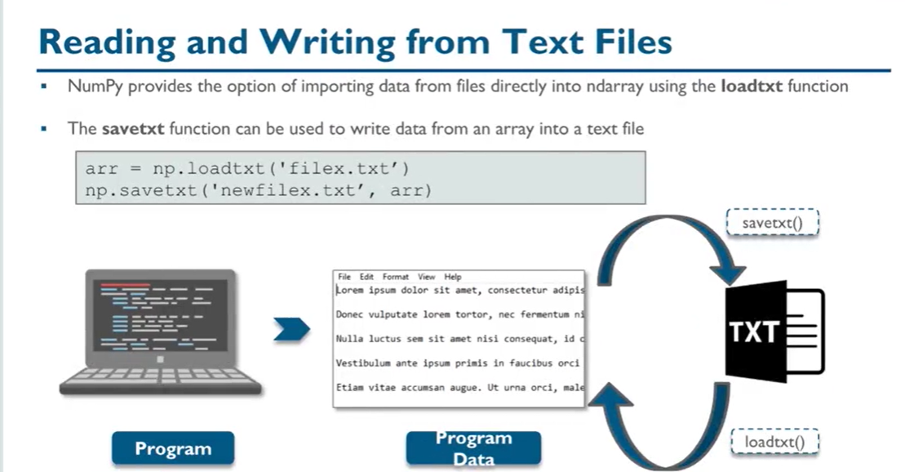

Slide 20
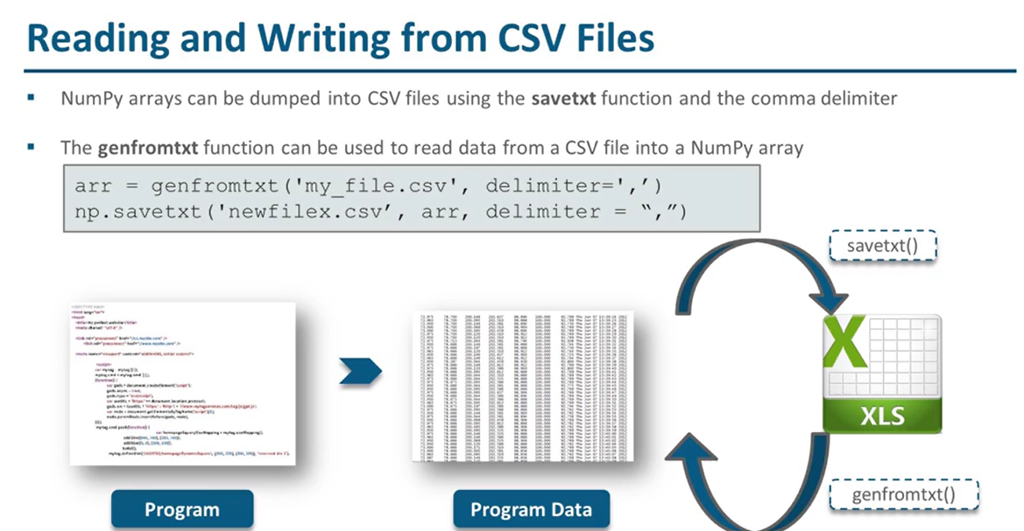

Slide 21
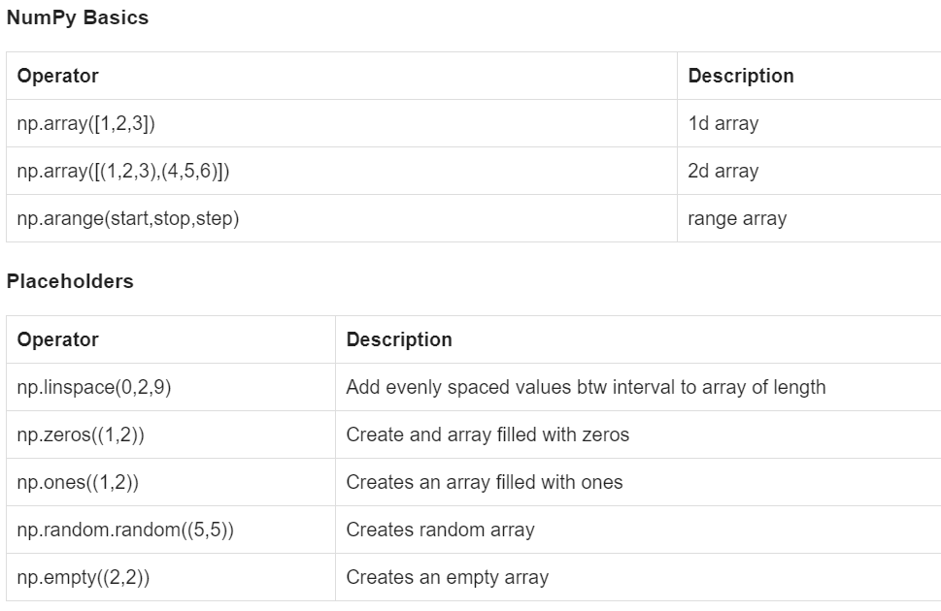
Numpy Summary

Slide 22
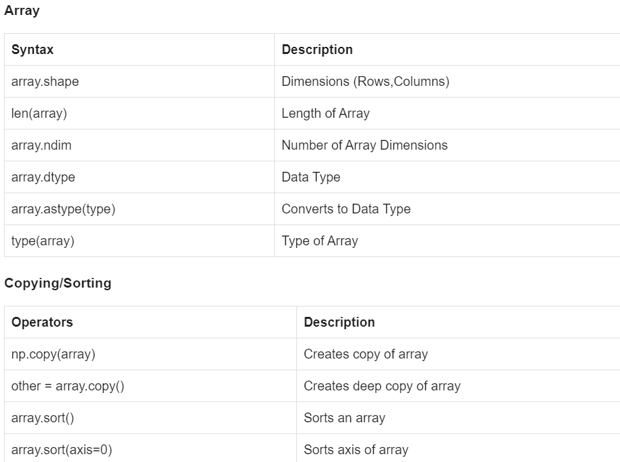
Numpy Summary

Slide 23
Numpy Sort
Array Sort
arr = np.array([3, 2, 0, 1])
print(np.sort(arr))
arr = np.array(['banana', 'cherry', 'apple'])
print(np.sort(arr))
Array Sort – Descending Order
arr = np.array(['banana', 'cherry', 'apple'])
print(np.sort(arr)[::-1])
Sort 2 D Array
arr = np.array([[3, 2, 4], [5, 0, 1]])
print(np.sort(arr))
Sort Array with Axis
arr = np.array([[3, 2, 4], [5, 0, 1]])
print (arr)
print (np.sort(arr, axis = 0))
print (np.sort(arr, axis = 1))

Slide 24
Numpy Sort 2D Descending
Sort 2D NumPy Array in decreasing Order Row-wise
import numpy as np
# Creating numpy array
arr = np.array([[3, 2, 4],
[5, 0, 1]])
# Sort 2D NumPy Array in decreasing order row-wise
arr = -np.sort(-arr)
print(arr)
Sort 2D NumPy Array in decreasing Order Column-wise
import numpy as np
# Creating numpy array
arr = np.array([[3, 2, 4],
[5, 0, 1],
[1, 9, 7]])
# Sort 2D NumPy Array in decreasing order row-wise
arr = -np.sort(-arr, axis=0)
print(arr)
Enter the Array
Multiply with -1
Sort the array
Multiply with -1

Slide 25
Numpy Delete
The numpy.delete() function returns a new array with the deletion of sub-arrays along with the mentioned axis.
Array Delete 2 D
Create 3 X 4 array
arr= np.arange(10,22)
arr2 = arr.reshape(3,4)
arr2
Delete 1st Row from array (0 for row 1 for column)
a= np.delete (arr2,1,0)
a
Delete 1st Column
a= np.delete (arr2,1,1)
a
Array Delete 1 D array
import numpy as np
arr= np.arange(10,19)
print (arr)
# Delete based on Index
arr= np.delete (arr, 2)
print (arr)
arr= np.arange(10,19)
arr= np.delete (arr, [2,5])
print (arr)
arr= np.arange(10,19)
arr= np.delete (arr, [2,5,8])
print (arr)

Slide 26
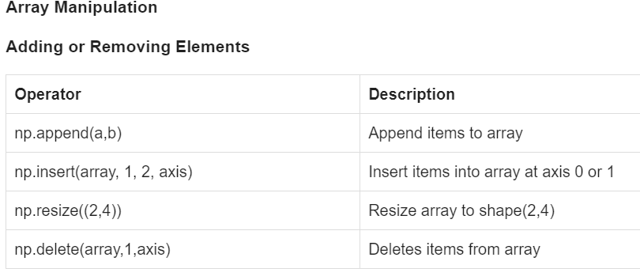
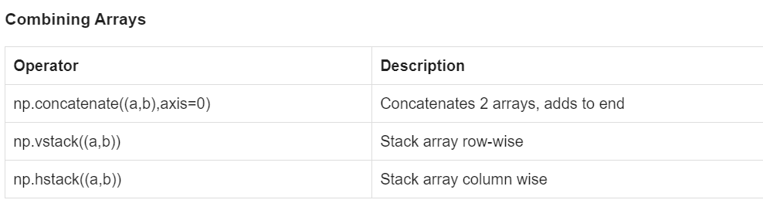
Numpy Summary

Slide 27
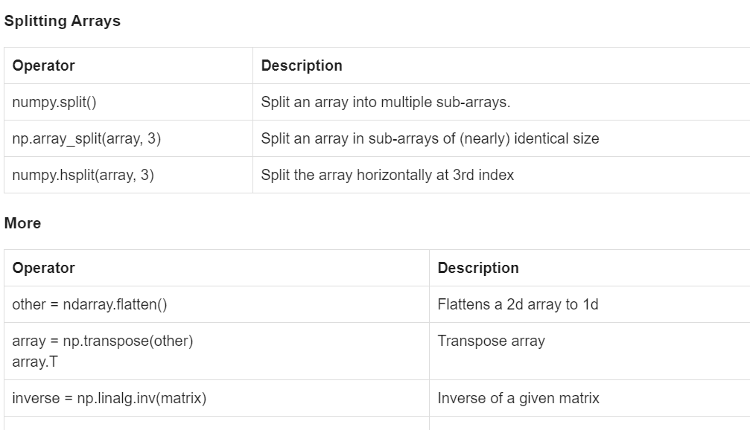
Numpy Summary

Slide 28
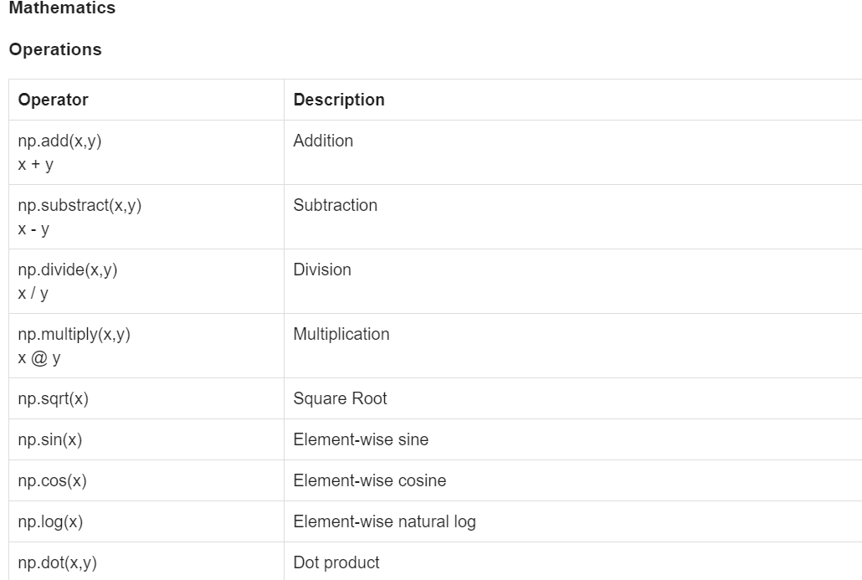
Numpy Summary

Slide 29
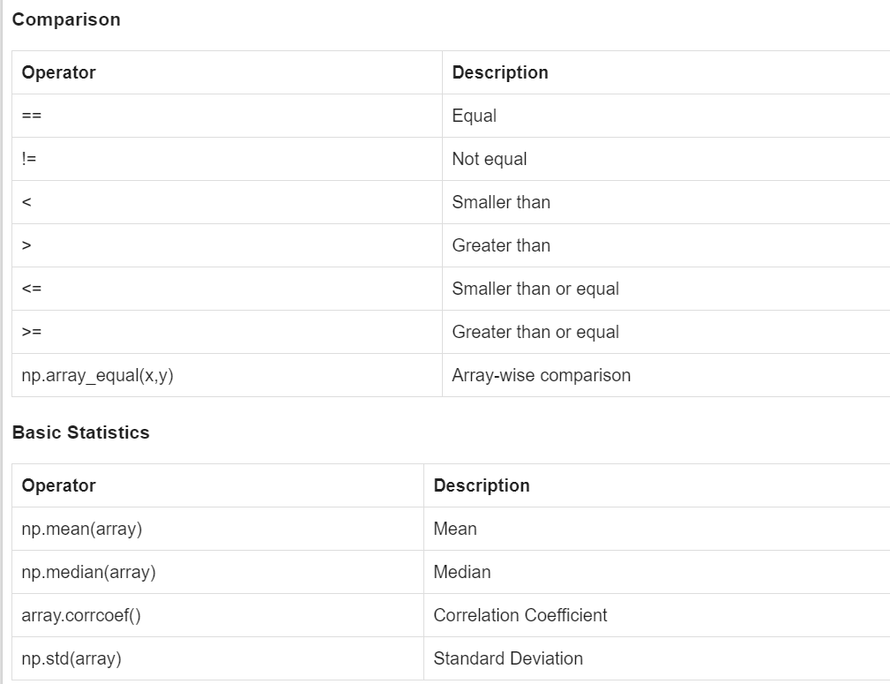
Numpy Summary

Slide 30
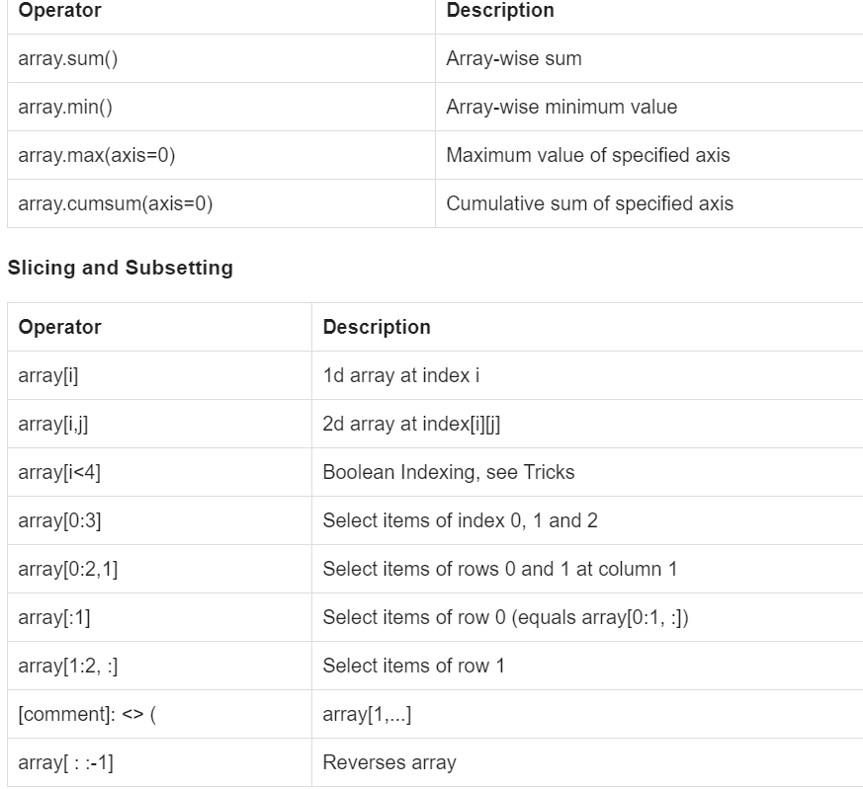
Numpy Summary

